Slide 1
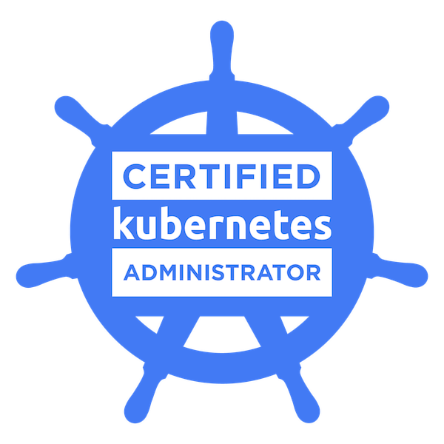

Slide 2
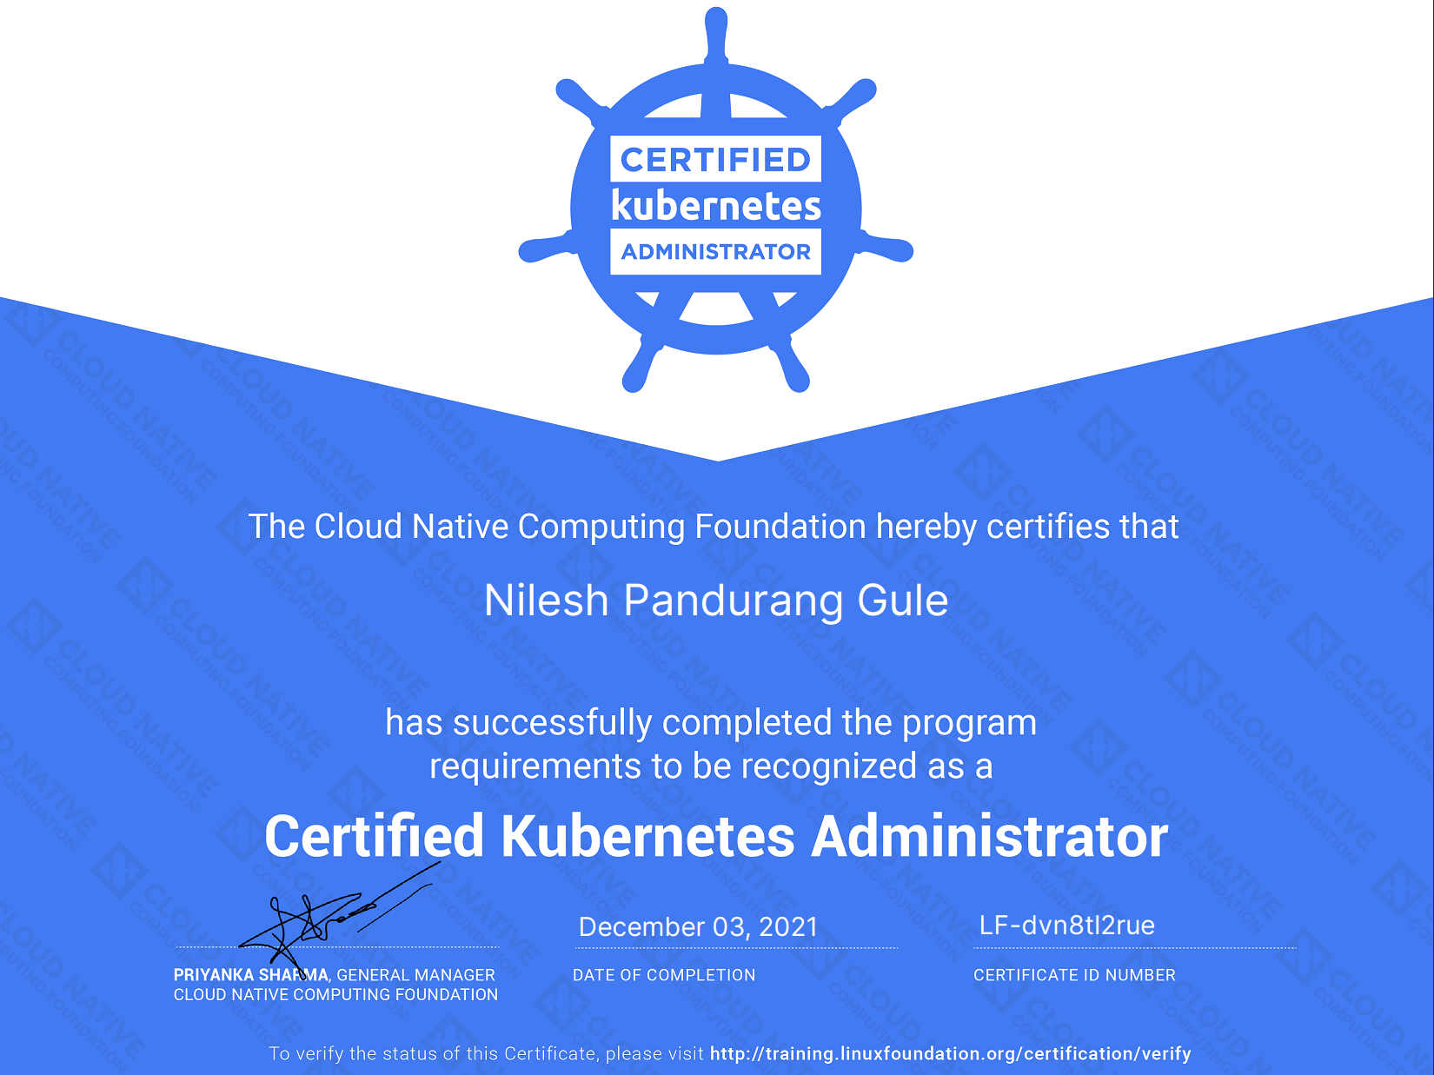

Slide 3


Exam Curriculum

Slide 4
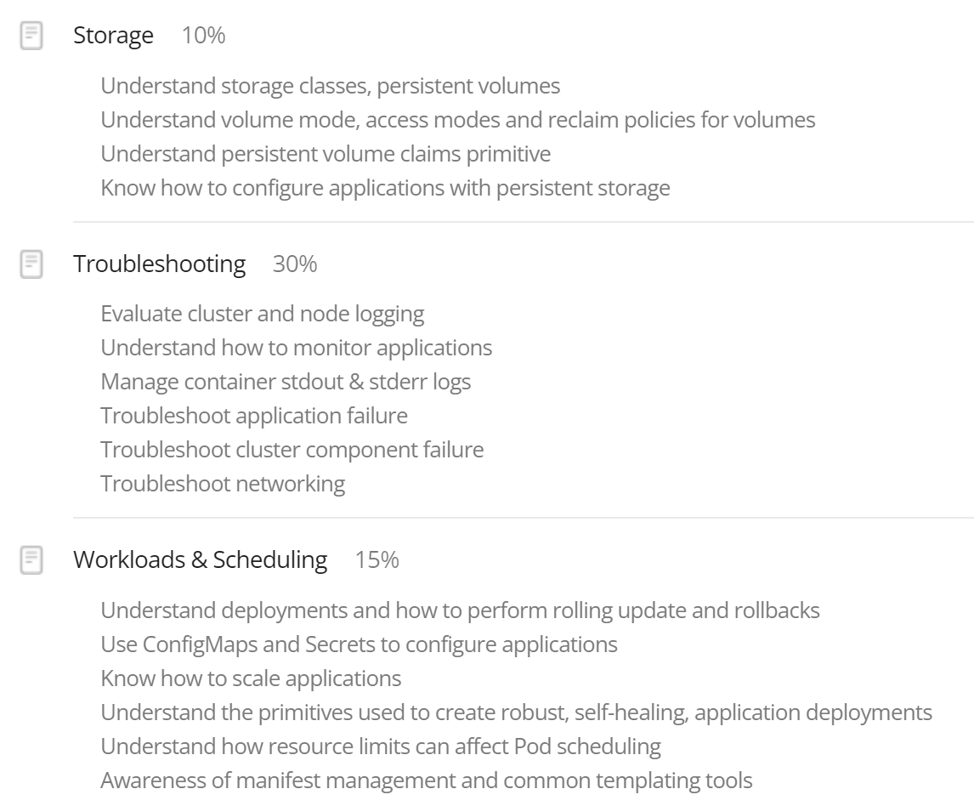
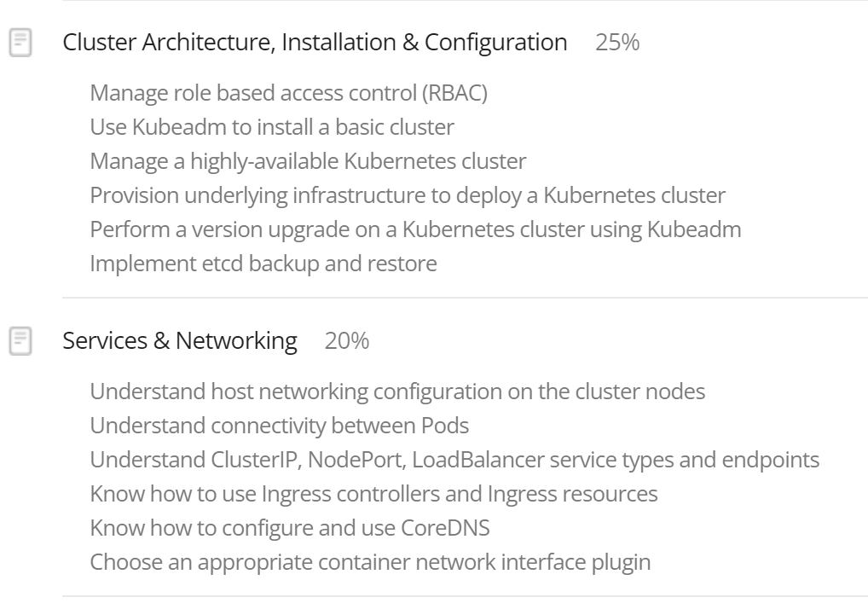
Exam Curriculum
2 hours time limit
66% minimum passing score
3 years validity
1 free retake
https://training.linuxfoundation.org/certification/certified-kubernetes-administrator-cka/

Slide 5

Resources

Slide 6
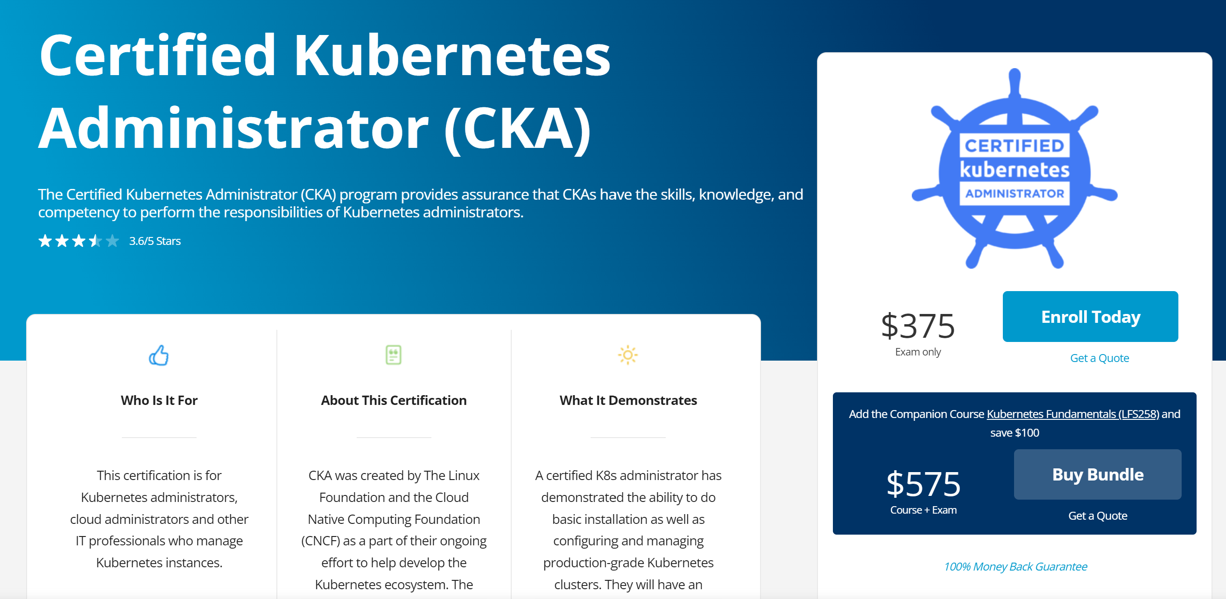


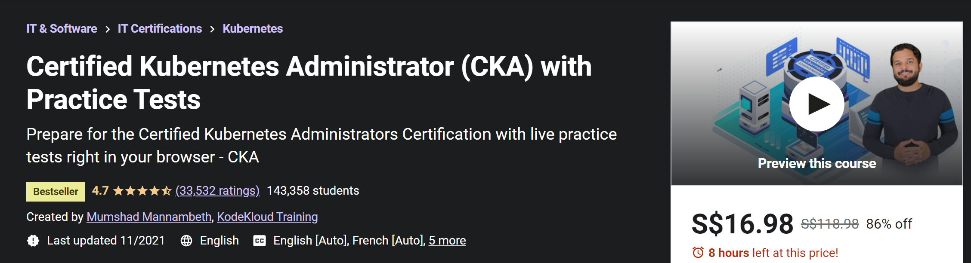
References
Kubernetes docs
Kubernetes.io/docs
Kubernetes.io/docs/tasks
Kubectl cheat sheet
eLearning
Linux Foundation CKA + Kubernetes fundamentals bundle
Udemy – CKA with Practice Tests (alternative)

Slide 7


References
Github repos
Shubham Tatmavasi CKA
Walid Shaari Kuberentes Certified Administrator
Nilesh Gule CKA prep
Denny Zhang kubectl cheatsheet
Ahmet Alp Balkan Kubernetes network policy recipes
Blogs
Be fast with kubectl
How to nail Kubernetes certification exams
Codefresh Kubernetes cheat sheet
CKA practical challenge series
Rudi Martinsen CKA resources

Slide 8

Tips

Slide 9


Tips
Before exam
During exam
Watch out for discounts (black Friday / Cyber Monday etc.)
Imperative commands
Be efficient with kubectl commands & options
Learn basic vi or nano editor commands
Practice, practice, practice
Bookmark specific links
Practice exam
Killer.sh CKA simulator 36 hours access, 2 attempts
Use external monitor (recommended)
Enable kubectl autocompletion
Create aliases
Update vimrc
Time management
Use copy feature instead of typing
Use notepad feature to note things
Flag questions for review
Don’t spend too much time on single question
Verify solution after completion of task

Slide 10

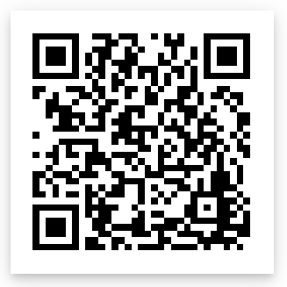




Nilesh Gule
https://bit.ly/youtube-nileshgule
Architect | Microsoft mvp
“Code with Passion and
Strive for Excellence”
NileshGule
nileshgule
@nileshgule
Nilesh Gule
www.handsonarchitect.com

